Slide 1
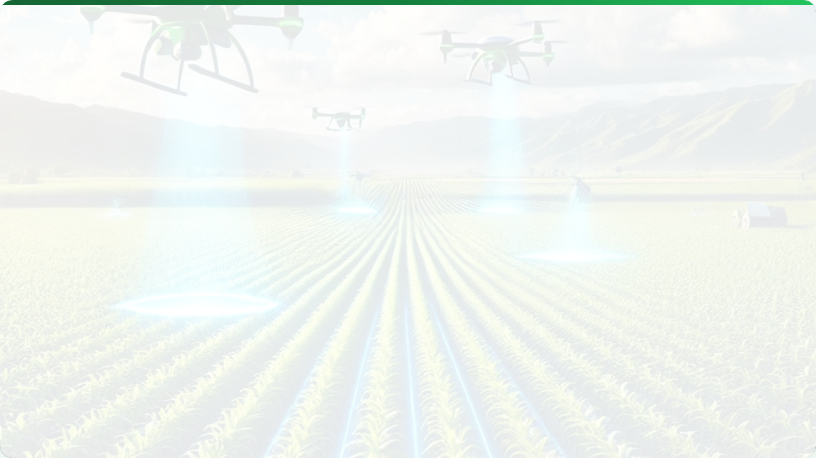



SENSORS & CONTROLS IN
PRECISION AGRICULTURE
Lecture 1: Introduction & Fundamentals
AGE 418
Dr. Kadeghe Fue

Slide 2




Lecture Roadmap
Concepts
Systems
Defining Precision Agriculture (PA)
Economic & Environmental Impact
Historical Evolution & Drivers
Sensor Systems (The "Eyes")
The PA Management Cycle
Control Systems (The "Hands")

Slide 3
Defining Precision Agriculture
"Doing the Right Thing,
at the Right Place,
at the Right Time,
in the Right Amount."
It is a management strategy that uses information technology to bring data from multiple sources to bear on decisions associated with crop production.
— THE 4 R'S PRINCIPLE

Slide 4






The PA Cycle: A Closed Loop
1. Measure
2. Analyze
3. Decide
4. Act
Data collection via sensors, satellites, and yield monitors to quantify variability.
Processing raw data into useful information (GIS maps, indices) to understand causes.
Creating prescription maps and management plans based on agronomic models.
Execution in the field using Variable Rate Technology (VRA) or robotics.

Slide 5
Evolution of PA
1980s: Concept
1990s: GPS Era
2000s: Automation
Today: IoT & AI
Grid soil sampling and manual variable lime application.
Civilian GNSS and Yield Monitors revolutionize mapping.
Auto-steer tractors and Variable Rate Technology (VRT).
Connected farms, Big Data, Drones, and Robotics.

Slide 6
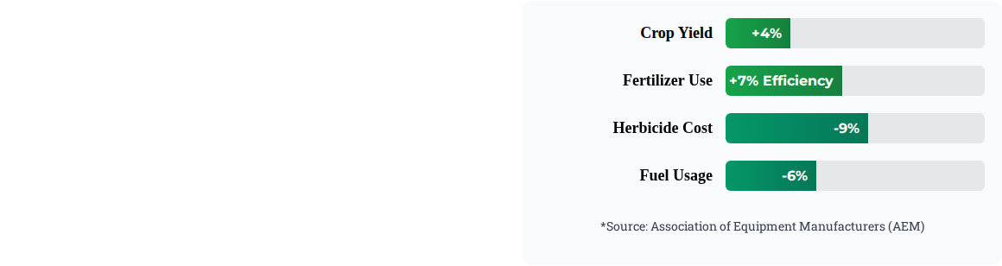
Economic Impact: Efficiency
Adopting PA technologies optimizes input usage, directly impacting the bottom line. Efficiency is key in modern farming.
Reduced Input Costs
Higher Yields per Hectare
Less Fuel Consumption

Slide 7
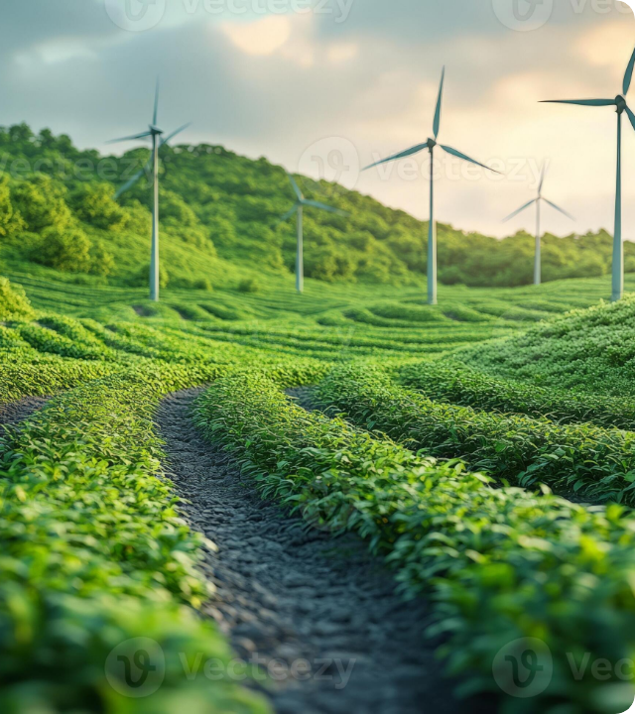
Environmental Stewardship
PA allows us to produce "More with Less," minimizing the ecological footprint of agriculture.
Reduced Runoff: Precise application prevents Nitrogen/Phosphorus leaching into water bodies.
Soil Health: Controlled traffic farming (CTF) reduces soil compaction.
Targeted Spraying: Site-specific application drastically cuts pesticide loads.

Slide 8


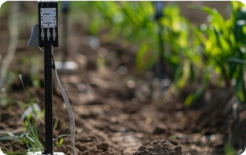

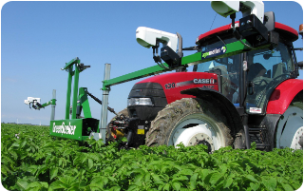

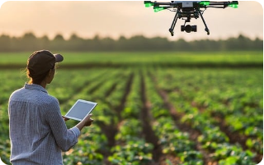
The "Eyes" of PA: Sensor Tech
Soil Sensors
Crop Sensors
Remote Sensors
Measure moisture, pH, EC, and temperature in real-time.
NDVI, thermal, and fluorescence for plant health status.
Drones and satellites for macro-level field monitoring.

Slide 9
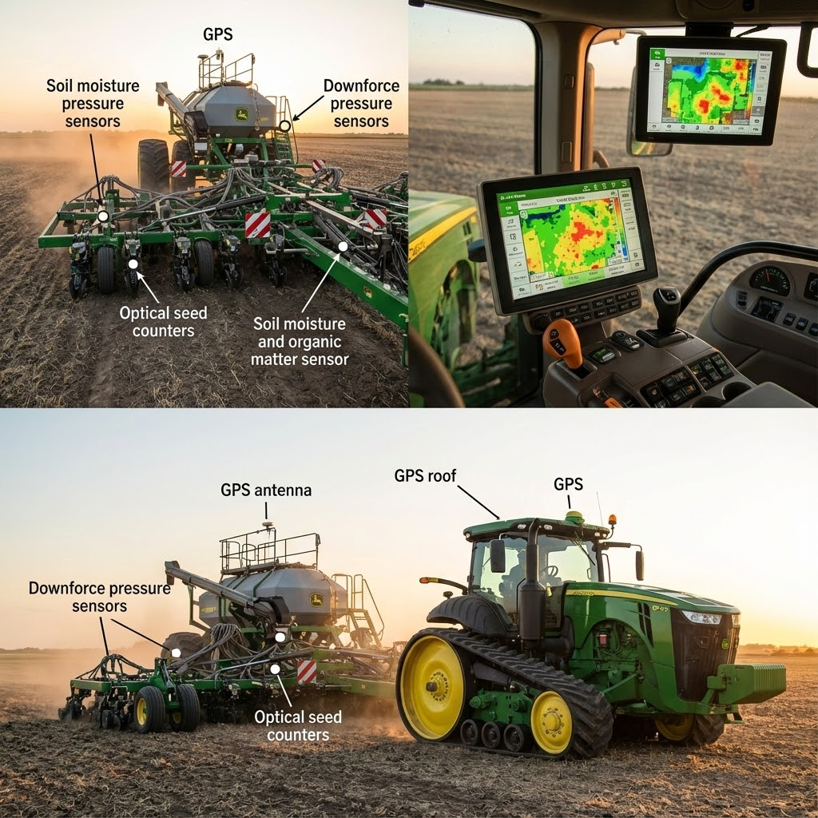

The "Hands" of PA: Control Systems
Sensors are useless without action. Control systems execute the decisions made from data.
Variable Rate Technology (VRT): Automatically adjusts flow rates of inputs based on map data.
Auto-Steer: GNSS guidance reduces overlap and operator fatigue.
Section Control: Automates boom nozzles to prevent spraying treated areas.

Slide 10
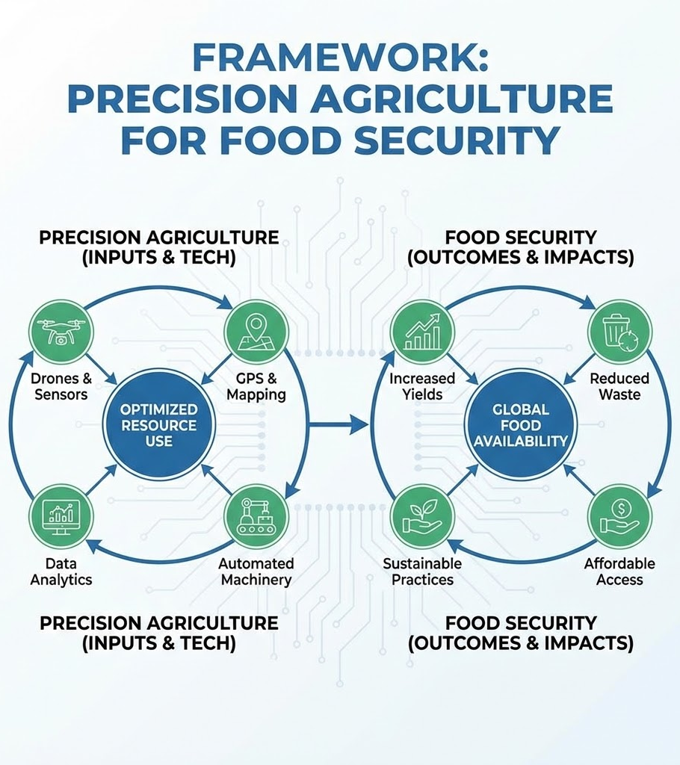
Why PA Matters: The Global Challenge
We face a critical intersection of population growth and resource scarcity.
9.7 Billion People: Projected global population by 2050 requiring a 70% increase in food production.
Limited Land: Arable land per person is decreasing. We cannot simply "plant more acres."
The Solution: We must increase efficiency per acre. Precision Agriculture is the tool to bridge this gap.

Slide 11


Lecture Summary
Key Takeaways
Looking Ahead
PA is about the "Right" input at the "Right" time/place.
In the next lectures, we will dive deeper into the technologies that make this possible.
It is a data-driven cycle: Measure -> Analyze -> Decide -> Act.
Next Class:
Lecture 2: GIS & GPS Fundamentals.
Please bring your laptops.
It offers both economic (ROI) and environmental benefits.

Slide 12

Questions?
Dr. Kadeghe Fue | AGE 418
Sokoine University of Agriculture

